Slide 1
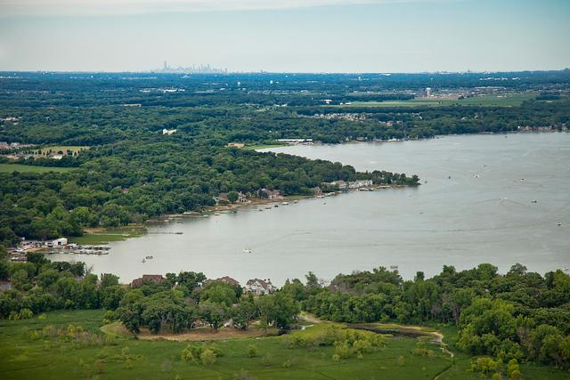

2026 Budget
Introduction
Town of Cedar Lake
Presented by:
Jennifer N. Sandberg, IAMCA, CMC, CPFIM
Clerk-Treasurer
Sue Haase, CPA,
Certified Public Accountant and Utility Account Specialist

Slide 2

Summary of Selected Cash Balances
Fund | 6/30/2025 | 12/31/2024 | 12/31/2023 | 12/31/2022 | 12/31/2021 | 12/31/2020
General | $4,501,982 | $4,178,801 | $4,361,543 | $5,076,767 | $4,787,348 | $3,158,900
MVH | $918,968 | $739,542 | $861,575 | $578,388 | $422,107 | $334,570
LRS | $813,775 | $862,768 | $666,230 | $548,351 | $397,051 | $290,817
CCD | $194,174 | $308,551 | $484,786 | $414,960 | $383,756 | $338,149
CCI | $43,192 | $35,213 | $35,181 | $29,327 | $20,202 | $15,416
CEDIT | $951,527 | $767,899 | $640,939 | $532,147 | $754,196 | $624,532
LOIT Public Safety | $455,572 | $321,425 | $199,068 | $137,143 | $121,515 | $98,345
Casino | $189,868 | $188,911 | $179,784 | $107,447 | $220,383 | $232,340
Redev Gen | $135,438 | $124,220 | $106,533 | $91,570 | $54,372 | $19,579
TOTALS | $8,204,496 | $7,527,330 | $7,535,639 | $7,516,100 | $7,160,930 | $5,112,648

Slide 3
Senate Bill 1
There is a tremendous amount of uncertainty regarding how Senate Bill 1 will impact municipalities.
The goal for our 2026 budget:
Operate with last year’s budget with minimal changes.
Manage and correct Bond Obligations
Submit for Growth Appeal

Slide 4
Budget Changes
2026 will be the same as our 2025 budget with some minor adjustments for Public Safety. Once we see how the new Senate Bill impacts us, we can begin to make changes as needed in the following year(s).
Adjustment in the Public Safety Retirement Program (77 fund) to accommodate the State Increase of 3%
Increase in Facility Line Item for New Police and additional Fire Building
Raises for Police and Fire Departments

Slide 5
Growth Appeal
This is our final year of eligibility for the Growth Appeal. Those funds will be applied to the General Fund.
Year | Certified Net Assessed Value (CNAV) | Adjustments (Circuit Breaker Credit Loss) | Assessed Value | Increase
2025 | $1,054,202,916 | $(116,046) | $1,054,086,870 | 1.1057 10.57%
2024 | $953,451,766 | $(156,842) | $953,294,924 | 1.0951 9.51%
2023 | $870,658,101 | $(475,875) | $870,535,301 | 1.1692 16.92%
2022 | $744,576,738 | $(46,592) | $744,530,146
2021 | $663,205,480 | $(75,254) | $663,130,226
Growth Appeal Average |  |  | 1.1233 12.33%

Slide 6
Bond Corrections
As a result of the potential impact of Senate Bill 1, and good accounting practices, we will be correcting an issue with our 2017 Bonds.
Additional payment to be made in the 2026 period
Eliminate the need for a temporary loan from other line items before our disbursement is received
This will allow us to properly close out the bond within the 2026 Budget.

Slide 7
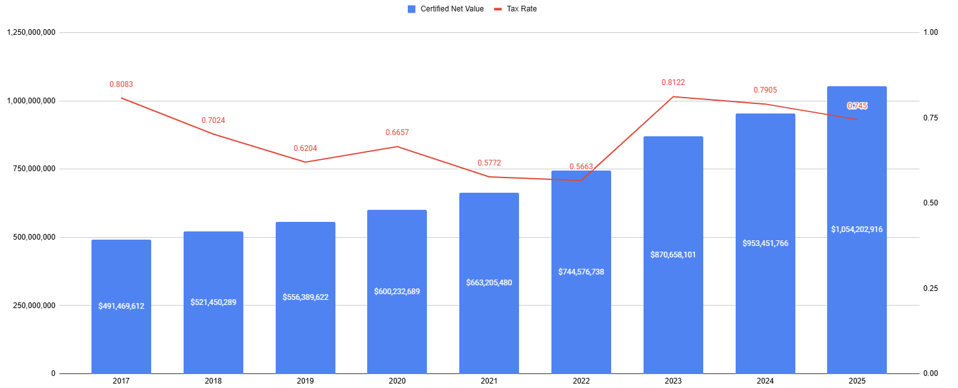
Sustainability Projection
SUMMARY OF HISTORICAL PROPERTY TAX RATES AND LEVIES

